Slide 1

Childcare in Northern Ireland:
Is it working and for who?
Presented by:
Meghan Hoyt
Meghan.hoyt@wrda.net

Slide 2
Current Child Care Support Schemes in Northern Ireland
Universal Credit
Up to 85% of childcare costs can be reclaimed
There are maximum monthly limits
Must be with a registered provider
Childcare Vouchers
** Not accepting new entrants as of 2018**
Vouchers provided by your employer as part of a salary sacrifice scheme
Part of gross salary exchanged for vouchers which could be used to pay registered providers
Some employers do not provide the scheme
Must leave this scheme to join another
Tax-Free Childcare Scheme (TFC)
Started 2017 – UK wide scheme
Available to ‘working’ families for children under 12 (under 17 if disabled)
Can claim 20% of costs – up to a max of £2,000 per year (per child)
Must be registered provider AND the provider must be registered with the scheme
Northern Ireland Child Care Subsidy Scheme (NICSS)
Started 2024 – just NI
Extended in 2025 to include all children under 12
Provides 15% subsidy on child-care costs for those eligible for Tax-Free Scheme
Amount is capped at £184 per child per month

Slide 3
Key Challenges with Current System
Complex
  Many different types of providers. No standardisation or consistency
  Support system is difficult to navigate
Unaffordable
  The support schemes have not alleviated the cost to families
  Does not deal with rising costs
  Focuses on supporting ‘working families’ rather than providing universal, low-cost care
Quality of care
  Lack of standardisation impacts service provision
Labour conditions
  Care workers remain undervalued and employment can be precarious

Slide 4
Negative Outcomes of Current System
Barrier to Employment
Lack of affordable childcare acts as a barrier to employment, particularly for women
Adverse Outcomes for Children
The lack of high quality, universal childcare is an evidence-based policy for improving a wide range of outcomes for children. It is particularly impactful for children experiencing socio-economic deprivation
Mental Health of Parents
Lack of affordable childcare puts strain on families
Devaluing of Care Work
Impacts workers and broader society when we do not value and invest in this essential labour

Slide 5

In 2019, a coalition of civil society organisations came together to demand the development of a childcare system that fulfilled these key demands.
In 2023, parent-led activist group Melted Parents was formed. It currently has 20, 000 members.

Slide 6

In 2025, the Childcare for All Campaign was revived.
Organisations came together (again) to demand a Childcare Strategy that was fit for purpose.

Slide 7
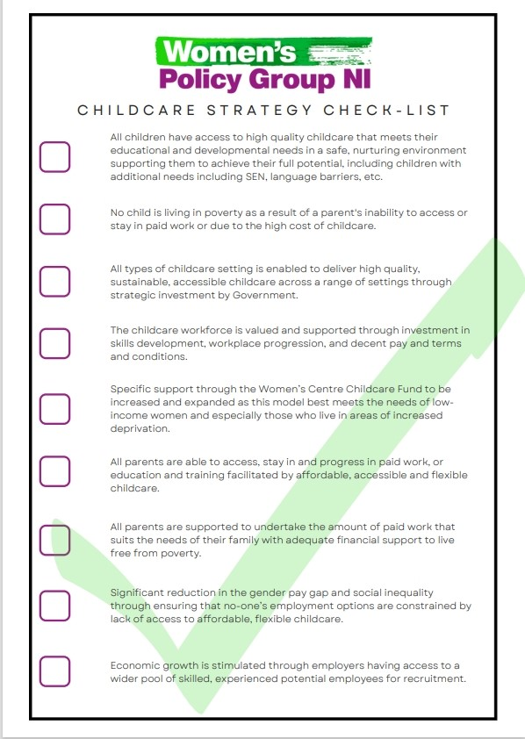
At an event at Stormont in 2025, the Campaign launched this check list in advance of the release of the Childcare Strategy – a checklist for MLAs when deciding whether or not to support the Strategy.

Slide 8

The Department of Education launched the Draft Strategy in Dec 2025.

Slide 9
Draft Strategy Overview
Theme One: Giving Children the best start through ELC
1.1 Deliver Universal, full time pre-school provision
1.2 Deliver ELC services for disadvantaged children and those with additional needs
1.3 Expand developmental provision for children 2-3
1.4 Promote high quality provision
Theme Two: Making childcare more affordable and supporting families
2.1 Make childcare more affordable
2.2 Improve the information and support for families
Theme Three: Supporting a sustainable, high-quality ELC sector
3.1 Build the sustainable capacity of the ELC sector

Slide 10
Reflections on the Draft Strategy
Commitment to increase funded pre-school places across NI
Concern:
Pace of change – how quickly will new places be available?
Removal of prioritisation of socially disadvantaged children when applying for pre-school places
2) Commitment to expand Sure Starts/Toybox/Pathway Programmes
Concern:
These services are already stretched and cannot solely relied on to address disadvantage
3) Commitment to increase affordability
Concern:
The NICSS scheme risks excluding families with significant need – supports those who are ‘eligible’ consistently framed as ‘working families’
The NICSS scheme does not deal with prices rises
Relies on figures that do not measure informal childcare, ensuring that it will remain a feature of the system in the future

Slide 11
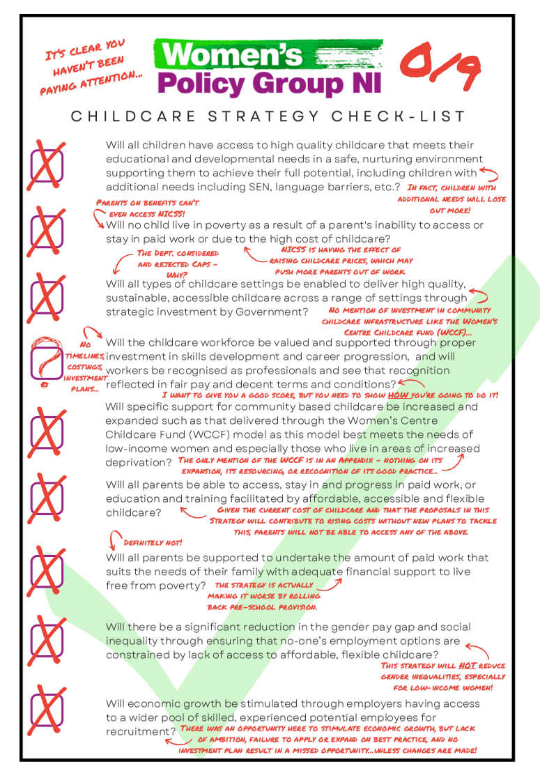
Campaigners are finding it difficult to support the Strategy.
While the objectives appear well intentioned – the actions risk increasing inequality and undermining key commitments to equity, standardisation and affordability.

