Slide 1



Scottish Child Payment
Stephen Sinclair
Scottish Poverty & Inequality Research Unit
Glasgow Caledonian University
Presentation to All-Island Social Security Network, 11th May 2026

Slide 2

Structure
Background to the Scottish Child Payment
Key features of the Scottish Child Payment
Impact of the Scottish Child Payment
Scottish Child Payment in Context

Slide 3
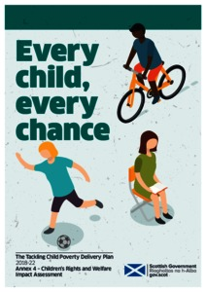
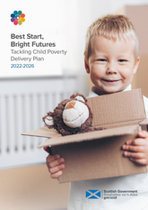
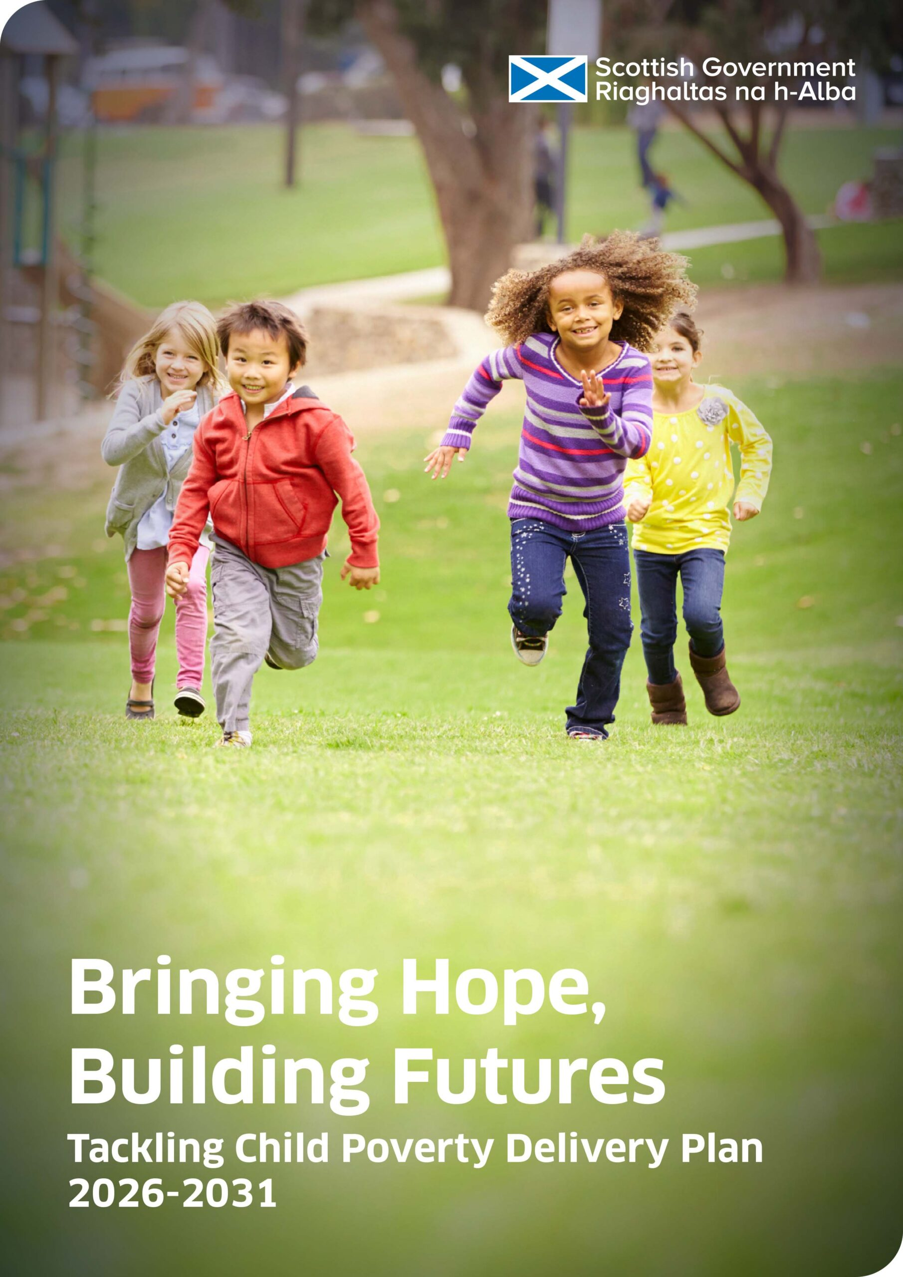
Background to the Scottish Child Payment #1
Child Poverty (Scotland) Act 2017: ‘eradicate’ poverty = 4 targets met by 2030/31:
<10% of children in Relative poverty (2024/24 interim target <18%)
<5% of children in ‘Absolute’ poverty (2024/24interim target <14%)
<5% of children in Combined Low Income and Material Deprivation (2024/24 interim target <8%)
<5% of children in Persistent poverty (2024/24 interim target <8%)
Child Poverty Delivery Plans:
2018-22: Every Child, Every Chance
2022-26: Best Start, Bright Futures
2026-30/31: Bringing Hope, Building Futures
Annual Progress reports
Poverty & Inequality Commission – annual scrutiny and advice report

Slide 4
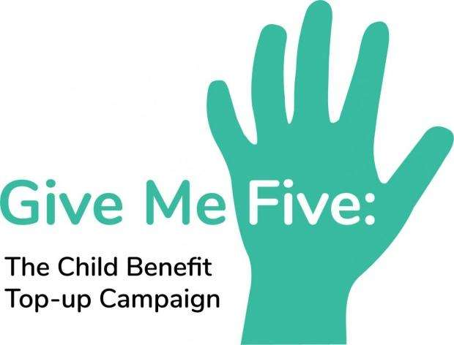
Background to the Scottish Child Payment #2
2016: £5 Child Benefit top-up would reduce child poverty in Scotland by 30,000, after housing costs (Keung and Bradshaw)
2017: CPAG ‘Give Me Five’ campaign
2021: Scottish Child Payment introduced - £10 per week to families with a child aged under 6 years old
Two child limit does not apply
April 2022: SCP doubled to £20 per child pw
November 2022: increased to £25 pw and extended to under 16s
Uprated annually with CPI inflation rate
2026 value = £28.20 per child pw
2026 Scottish Government Budget: SCP premium of £40 pw for children aged under 1 year old from 2027

Slide 5
Key Features of the Scottish Child Payment
321,375 children benefiting from SCP in December 2025
94% take up rate
2025/26 cost = £471m
Total cost to date = £1.3 billion
Equivalent UK benefit would cost £4.2 billion per year
For speed and efficiency SCP was introduced as a top up to existing UK benefits (chiefly Universal Credit)
Administered by Social Security Scotland but tied to UC
Potential ‘cliff edge’: SCP is not tapered, so withdrawn if household loses UC eligibility
Social Security (Amendment) (Scotland) Act 2025 could be used to make SCP stand-alone

Slide 6
Impact of the Scottish Child Payment #1
Danny Dorling: SCP is the single intervention that produced the largest fall in child poverty anywhere in Europe in the last 40 years
Child Poverty Action Group estimates SCP prevents approx. 40,000 children in Scotland from experiencing poverty
Poverty & Inequality Commission 2025 scrutiny report: modelling suggests SCP delivering around a 4 percentage point reduction in relative child poverty
Impact not clear in annual poverty statistics due to Family Resources Survey limitations
Testimony from families: ‘The Scottish child payment has been a “game changer” for me. It has enabled me to invest in a more nutritious diet that fuels my son adequately during his school day.’ (Lisa, single parent, Changing Realities project)

Slide 7
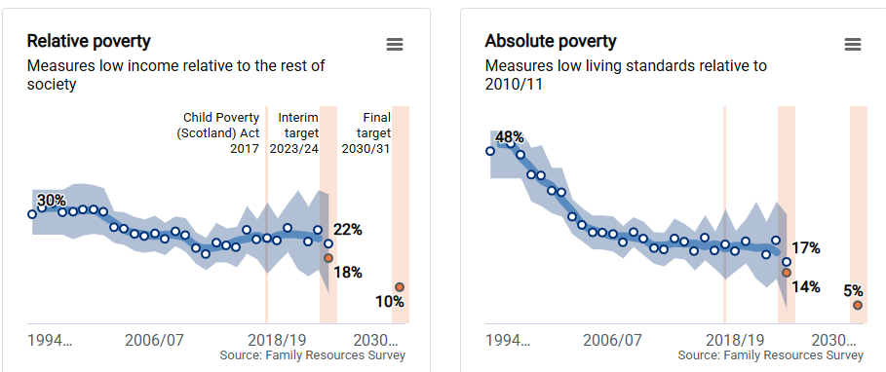
Impact of the Scottish Child Payment #2

Slide 8
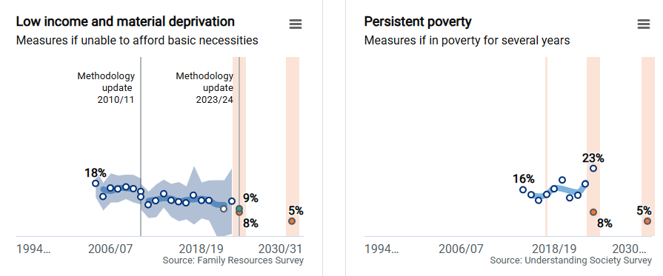
Impact of the Scottish Child Payment #3

Slide 9
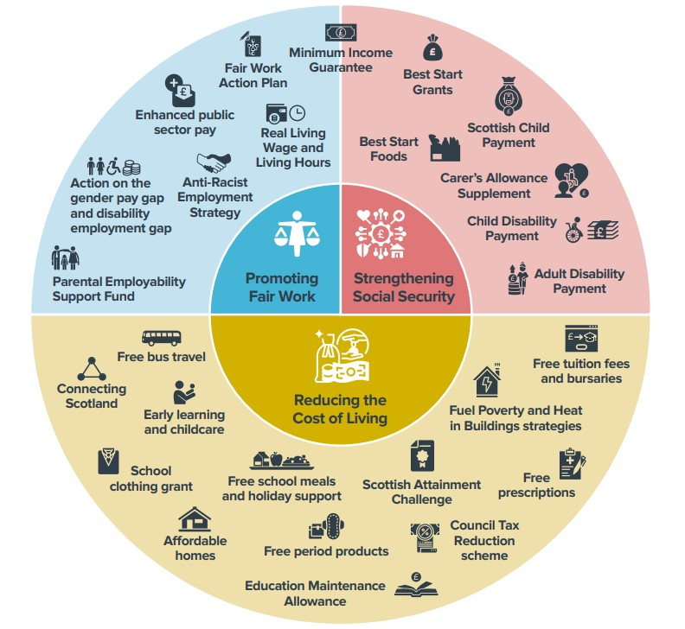
Scottish Child Payment in Context
SCP is part of a wider child poverty strategy
‘Five Family Payments’ SCP +
Best Start Grant Pregnancy and Baby Payment
Best Start Grant Early Learning Payment
Best Start Grant School Age Payment
Best Start Foods
Other ‘Social Wage’ components:
Baby Box
Free school meals
Childcare
Mitigating UK government policies

Slide 10
Thank you for listening
stephen.sinclair@gcu.ac.uk
https://www.gcu.ac.uk/aboutgcu/academicschools/gsbs/research/spiru

